Slide 1
InsurAI Corporate Policy Automation and Intelligence System
Presented By: Seelam Karunya
Technologies: React JS, MySQL , Java Spring Boot

Slide 2
Introduction
The main goal of the project is to provide an insurance management platform for automating and simplifying the most important operations: user authentication, policy selection, plan management, appointment scheduling, voice customer assistance, and admin-level user monitoring..

Slide 3
Objectives
Develop a centralized web application for managing different insurance policies
Provide secure login for users and admin
To allow users to view insurance plans and book appointments
Enable admins to manage users, appointments, and queries
To simplify insurance services using digital automation

Slide 4
System Architecture
Frontend: React JS
Backend: Spring Boot
Database: MySQL
Security: JWT Authentication
Voice Query
Multilingual System

Slide 5
Features Implemented
User & Admin Login and Registration
Role-based access (User / Admin)
Insurance plan management
Appointment booking with insurance type selection
Admin dashboard for monitoring users and appointments
Customer query management
Responsive and user-friendly UI

Slide 6
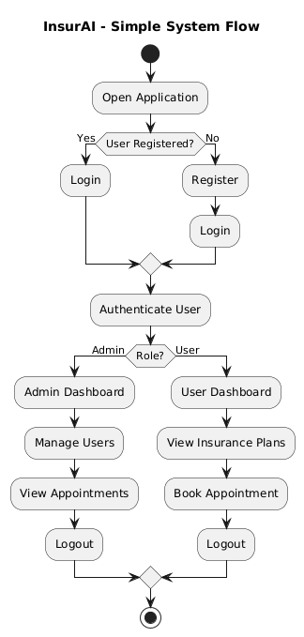

Slide 7
System Methodology
Requirement analysis to identify system needs
Database design for users, plans, and appointments
Backend development using Spring Boot REST APIs
Frontend development using React components
Integration using Axios
Testing and debugging
Final deployment on local server

Slide 8
Modules
User Module
Registration and Login
View insurance plans
Book appointments
Voice queries
Contact page

Slide 9
Modules
Admin Module
Admin login with special key
View all users
View and manage appointments
Handle customer queries
Analytics & Reports

Slide 10
System Overview
InsurAI is a web-based insurance management system
Supports multiple insurance types: Health, Car, Shop, Travel,etc.
Users can:
Register and login
View insurance plans
Book appointments
Raise queries
Admin can:
View users and appointments
Manage insurance plans
Handle customer queries
Built using React (frontend) and Spring Boot (backend) with MySQL database

Slide 11
Acknowledgment
I would like to express my sincere gratitude to Infosys Springboard for providing this internship opportunity.
I also thank my mentors and faculty for their guidance and support throughout the project. This project helped me gain practical knowledge in full-stack web development.

Slide 12
Conclusion
The InsurAI project provides an easy and secure way to manage insurance policies online. It allows users to view plans and book appointments, while admins can manage users and appointments efficiently. This project helped in learning full-stack web development using React, Spring Boot, and MySQL.

Slide 13
Thank You

